Slide 1

News Analytics and Social Media Post Generator
Group 5

Slide 2
—Dave Willis
"Don’t use social media to impress people; use it to impact people."

Slide 3

About us
News Analytics and Social Media Post Generator is a smart content marketing tool that analyzes trending news topics and generates relevant social media posts to boost engagement and audience reach efficiently.

Slide 4
But Why you need it?
Figure out yourself, JK

Slide 5
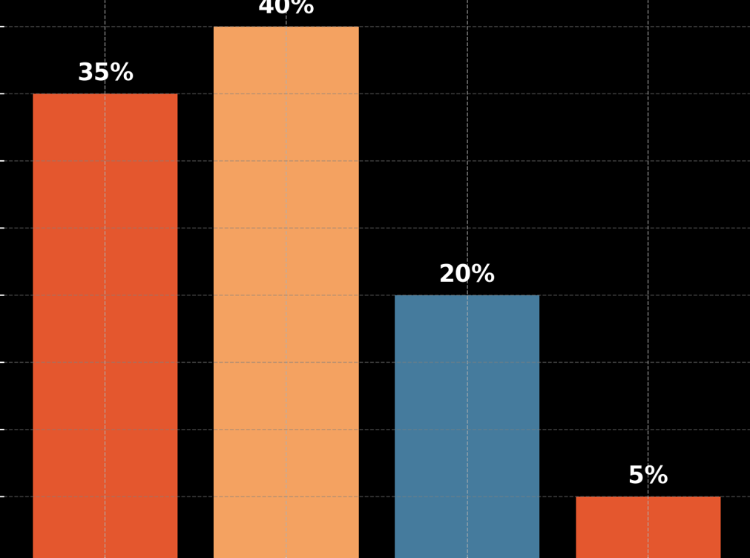
audience infographics
Young influencers
Professionals & brands
Marketers & analysts
Business executives

Slide 6
How it will help:
Save your time - Save money
Marketers spend 3.5 hours per week creating social media content.(HubSpot, 2023).
Automating content creation can reduce this time by up to 60%
more focus on strategy and engagement.
Makes Content Creation Accessible
54% of small businesses lack expertise or resources to create engaging posts. (Small Business Trends, 2023).
Simplifies content creation for non-marketers.
Reduce Cost - Save money x2
Hiring professional content creators or agencies can cost $500–$5,000/month.

Slide 7
what sets us apart?
Real-Time Trend Detection
Automated Post Creation
All-in-One Workflow

Slide 8
analyzing the competition
Feature | Our Solution | Google Trends | Hootsuite | Socialbakers
Real-Time Trend Detection | ✅ Yes, integrated with APIs and feeds | ❌ No | ❌ No | ❌ No
Automated Post Creation | ✅ Ready-to-publish posts generated | ❌ Not supported | ❌ Manual only | ❌ Manual only
All-in-One Workflow | ✅ Unified platform | ❌ Separate tools required | ❌ Separate tools needed | ❌ Separate tools needed

Slide 9
Guiding Principles
Data Accuracy and Quality
User-Centric Design
Real Time News Analytics
Bias Mitigation

Slide 10
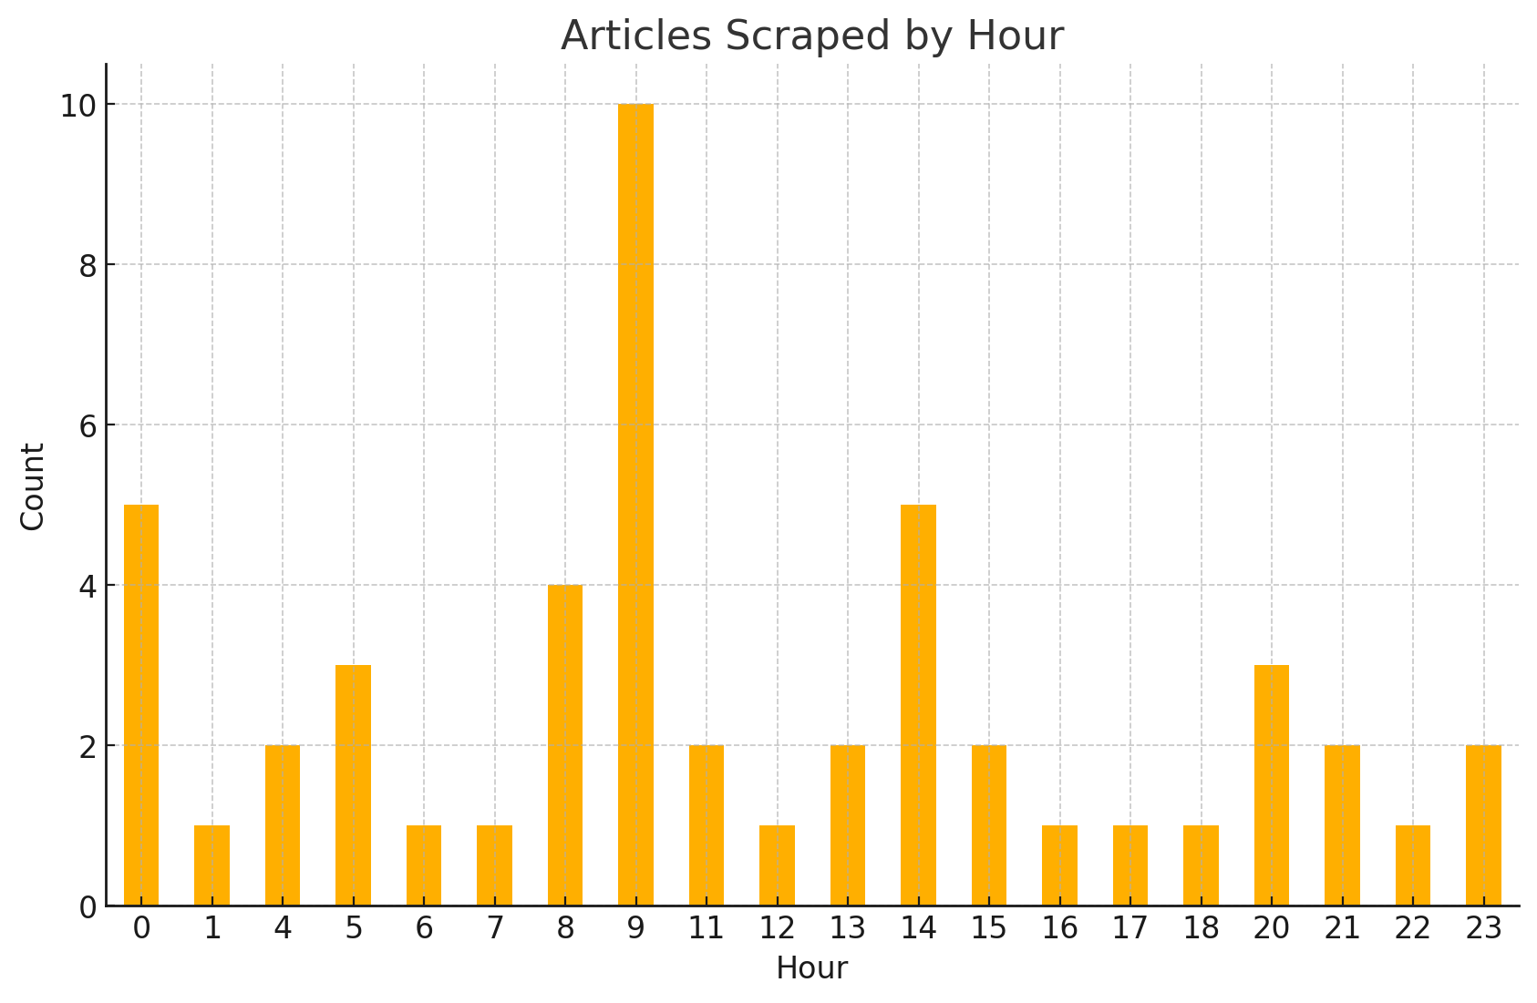
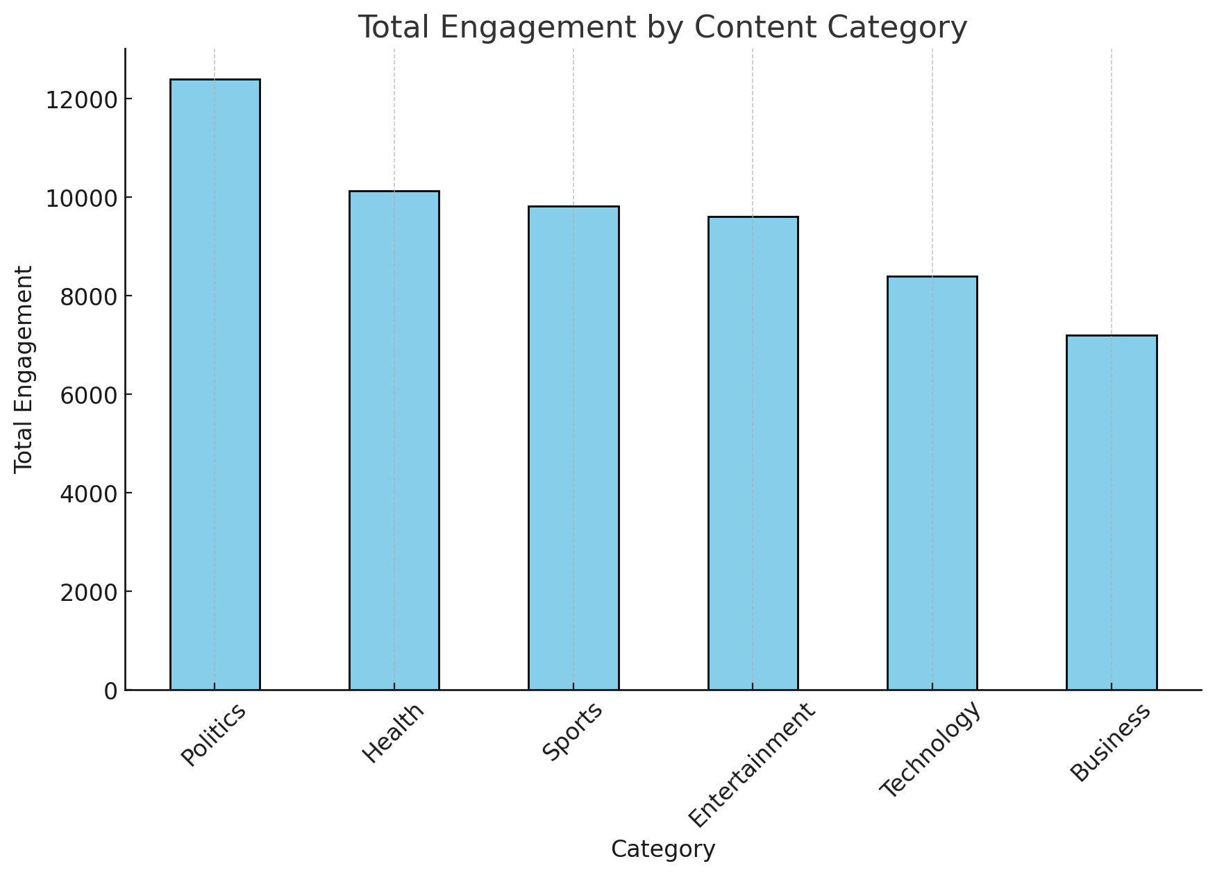
Data gathering & Insights
Data gathered through web scraping from yahoo and bbc news.
Key Insights:
Peak activity observed at 9 AM and 2 PM.
Minimal activity during late-night hours.
Suggestion: Optimize scraping schedule for these peak hours.
Politics drives the highest engagement, making it the most impactful category for audience interaction.
Health and Sports also perform well, offering strong secondary opportunities for content focus.
Business shows the least engagement, suggesting the need for a more tailored strategy.

Slide 11
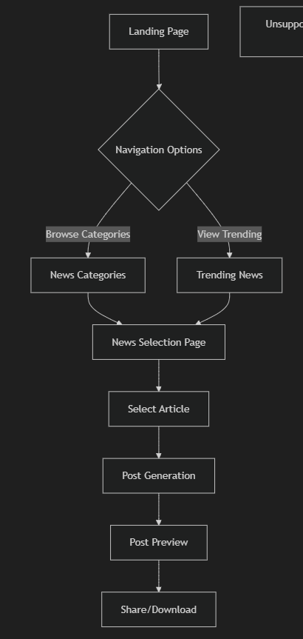
what is the
user flow?

Slide 12
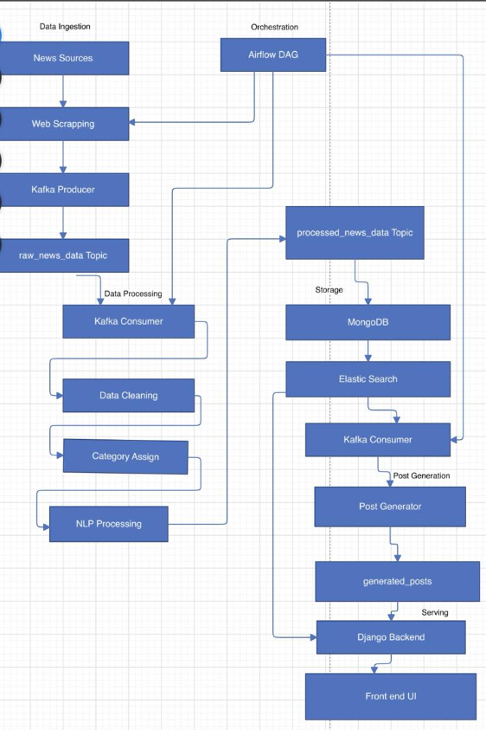
our Data Moves
Key Workflow
Data Ingestion (Collect news, scrape, send to Kafka).
Data Processing (Consume data, clean, categorize, NLP, send to Kafka).
Storage (Store processed data in MongoDB and Elasticsearch).
Post Generation (Generate social media posts from processed data).
Serving (Serve data to the frontend for display).
Orchestration (Airflow schedules and manages all steps).

Slide 13
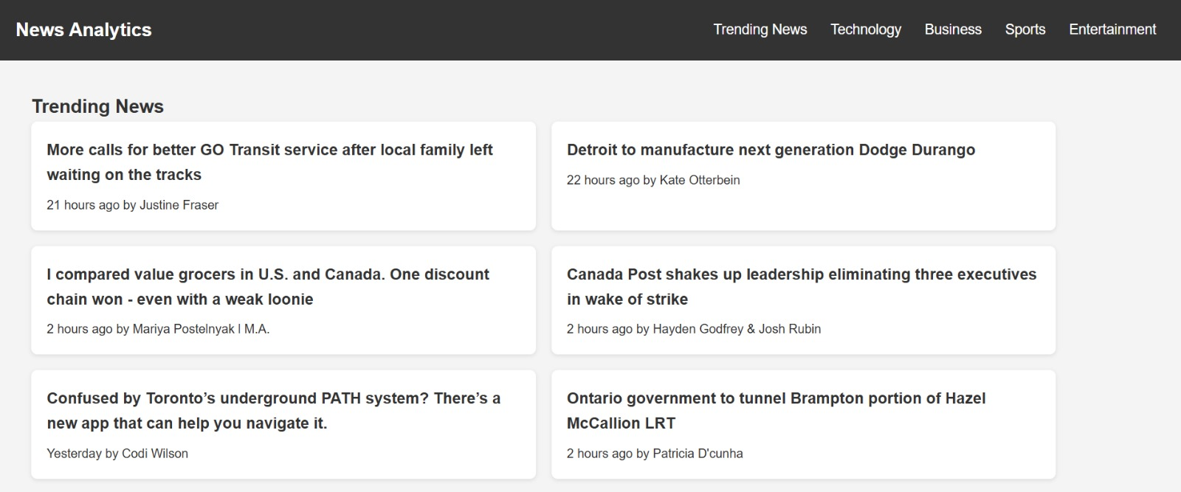
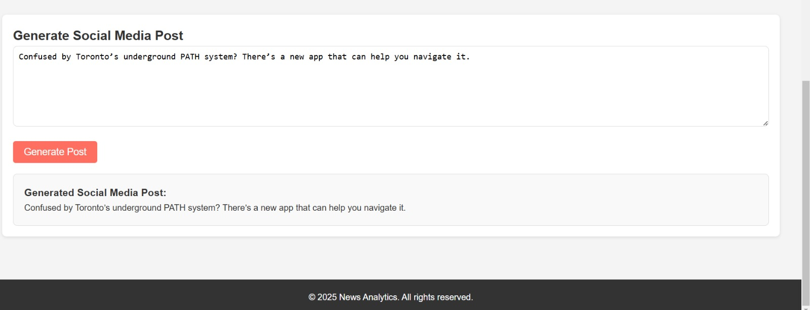
our USER INTERFACE
Generation of SM post from Selected trending News
Selecting News from trending Top News

Slide 14

thanks
Do you have any questions?
Email Us. Will try to get back to you in 24 hrs.
talk2group5@group5.com
group5.com

